Slide 1
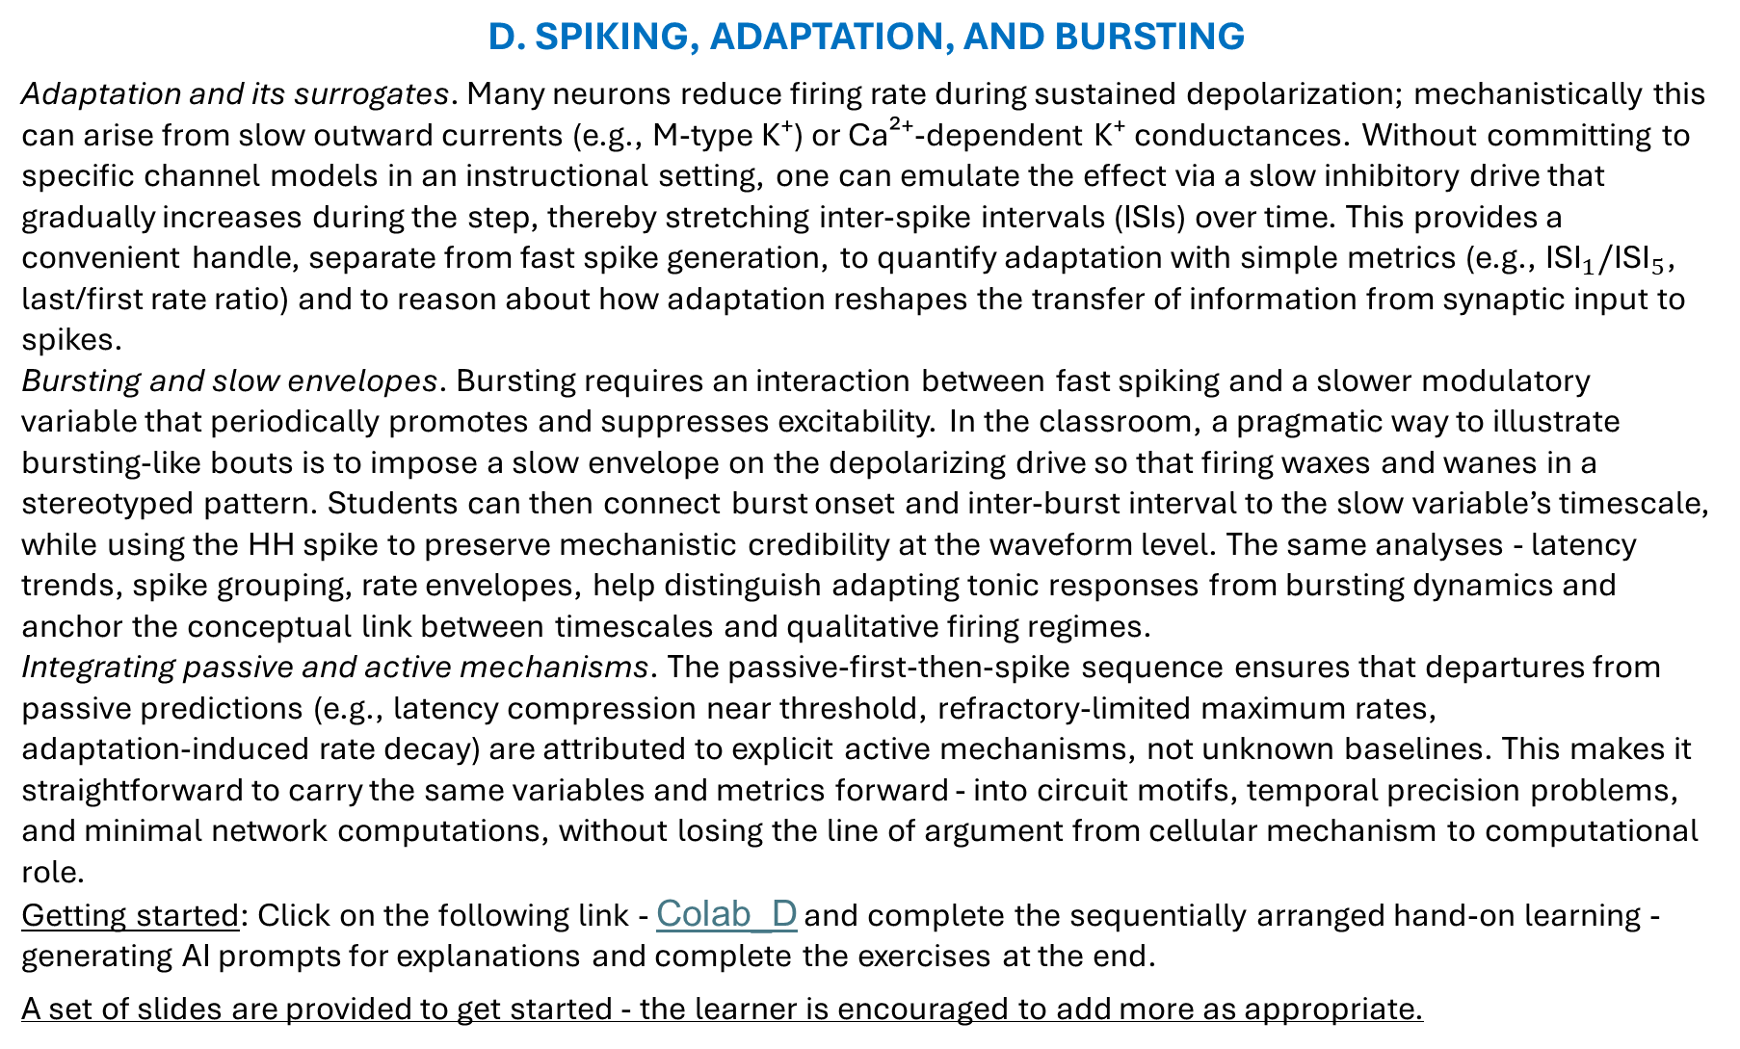
D. SPIKING, ADAPTATION, AND BURSTING
Adaptation and its surrogates. Many neurons reduce firing rate during sustained depolarization; mechanistically this can arise from slow outward currents (e.g., M‑type K⁺) or Ca²⁺‑dependent K⁺ conductances. Without committing to specific channel models in an instructional setting, one can emulate the effect via a slow inhibitory drive that gradually increases during the step, thereby stretching inter‑spike intervals (ISIs) over time. This provides a convenient handle, separate from fast spike generation, to quantify adaptation with simple metrics (e.g., ${\text{ISI}}_{1}/{\text{ISI}}_{5}$, last/first rate ratio) and to reason about how adaptation reshapes the transfer of information from synaptic input to spikes.
Bursting and slow envelopes. Bursting requires an interaction between fast spiking and a slower modulatory variable that periodically promotes and suppresses excitability. In the classroom, a pragmatic way to illustrate bursting‑like bouts is to impose a slow envelope on the depolarizing drive so that firing waxes and wanes in a stereotyped pattern. Students can then connect burst onset and inter‑burst interval to the slow variable’s timescale, while using the HH spike to preserve mechanistic credibility at the waveform level. The same analyses - latency trends, spike grouping, rate envelopes, help distinguish adapting tonic responses from bursting dynamics and anchor the conceptual link between timescales and qualitative firing regimes.
Integrating passive and active mechanisms. The passive‑first‑then‑spike sequence ensures that departures from passive predictions (e.g., latency compression near threshold, refractory‑limited maximum rates, adaptation‑induced rate decay) are attributed to explicit active mechanisms, not unknown baselines. This makes it straightforward to carry the same variables and metrics forward - into circuit motifs, temporal precision problems, and minimal network computations, without losing the line of argument from cellular mechanism to computational role.
Getting started: Click on the following link - Colab_D and complete the sequentially arranged hand-on learning - generating AI prompts for explanations and complete the exercises at the end.
A set of slides are provided to get started - the learner is encouraged to add more as appropriate.

Slide 2
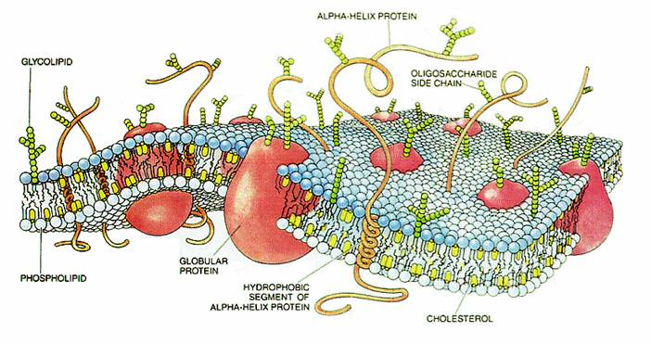
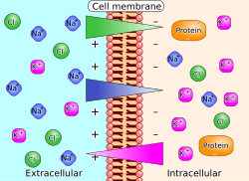
B1. Membrane as Capacitor + Leak as Resistor The bilayer stores charge (capacitance), while leak
channels provide conductive paths.
Together they produce RC‑like voltage time courses.
Self‑learning prompt: Using everyday analogies, explain why
membranes have capacitance and how leak affects voltage
over time. Predict the qualitative shape of V(t) to a small
current step.
B2. Ion Gradients as Batteries — Nernst Potentials
Each ion’s gradient corresponds to a reversal potential
via Nernst. Channel selectivity ties ion flow to driving force
Self‑learning prompt: Compute E_K and E_Na from given
concentrations. Explain how changing internal K⁺ or external
Na⁺ shifts the corresponding Nernst potentials.

Slide 3
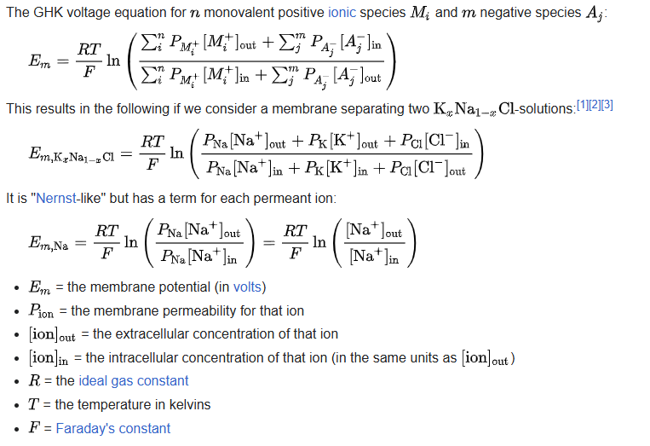
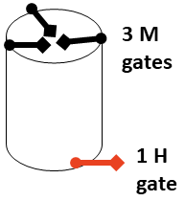
B3. Multiple Ions — Goldman–Hodgkin–Katz (GHK) and Resting Potential
With several permeant ions, resting V depends on relative permeabilities (P_K, P_Na, P_Cl), not just concentrations.
Self‑learning prompt:
Explain how changing
P_K/P_Na moves the
resting potential.
Provide a qualitative
graph showing resting
V as P_K increases.
B4. Voltage‑Gated Channels — Activation & Inactivation (m, h, n) Na⁺ channels: activation (m) and inactivation (h); K⁺: activation (n). Their voltage dependence creates spikes via positive and negative
feedback loops.
Self‑learning prompt: Describe how m, h, and n change with depolarization and how that sequence produces an action potential’s rise and fall.

Slide 4
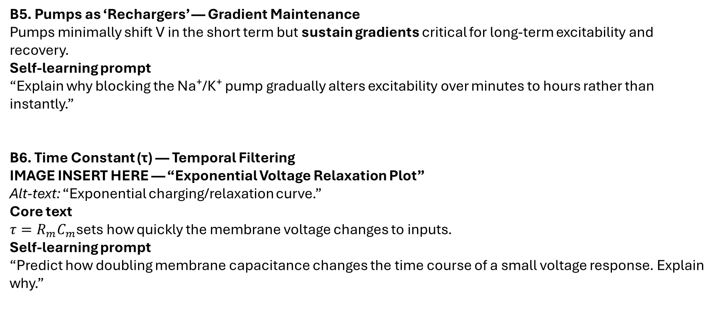
B5. Pumps as ‘Rechargers’ — Gradient Maintenance Pumps minimally shift V in the short term but sustain gradients critical for long‑term excitability and recovery.
Self‑learning prompt “Explain why blocking the Na⁺/K⁺ pump gradually alters excitability over minutes to hours rather than instantly.”
B6. Time Constant (τ) — Temporal Filtering
IMAGE INSERT HERE — “Exponential Voltage Relaxation Plot” Alt‑text: “Exponential charging/relaxation curve.”
Core text $τ=R_{m}C_{m}$sets how quickly the membrane voltage changes to inputs.
Self‑learning prompt “Predict how doubling membrane capacitance changes the time course of a small voltage response. Explain why.”

Slide 5
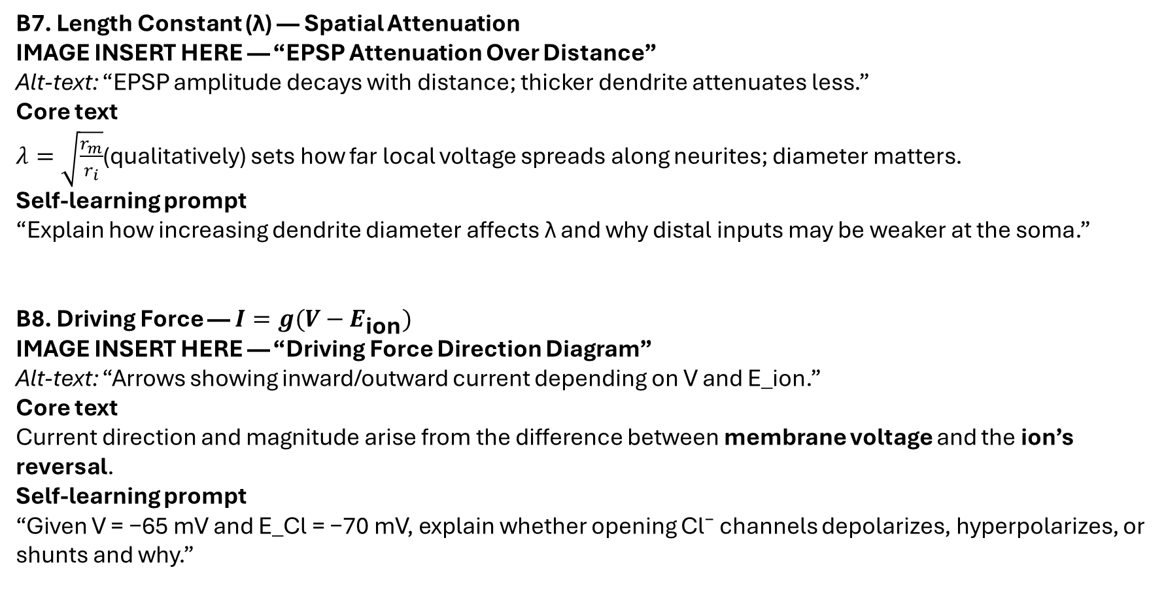
B7. Length Constant (λ) — Spatial Attenuation
IMAGE INSERT HERE — “EPSP Attenuation Over Distance” Alt‑text: “EPSP amplitude decays with distance; thicker dendrite attenuates less.”
Core text $λ=\sqrt{\frac{r_{m}}{r_{i}}}$(qualitatively) sets how far local voltage spreads along neurites; diameter matters.
Self‑learning prompt “Explain how increasing dendrite diameter affects λ and why distal inputs may be weaker at the soma.”
B8. Driving Force — $I=g(V−E_{\text{ion}})$
IMAGE INSERT HERE — “Driving Force Direction Diagram” Alt‑text: “Arrows showing inward/outward current depending on V and E_ion.”
Core text Current direction and magnitude arise from the difference between membrane voltage and the ion’s reversal.
Self‑learning prompt “Given V = −65 mV and E_Cl = −70 mV, explain whether opening Cl⁻ channels depolarizes, hyperpolarizes, or shunts and why.”

Slide 6
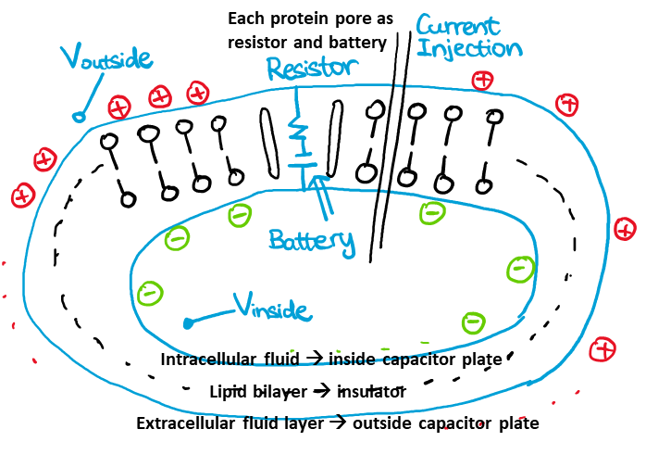
B9. Myelination — Changing Effective Membrane Properties Myelin reduces capacitance and increases resistance in internodes, enabling saltatory conduction between nodes.
Self‑learning prompt “Predict how demyelination affects signal propagation and threshold at nodes.”
B10. Hodgkin–Huxley in a Nutshell — The Membrane Equation The membrane equation combines capacitance, conductances, and driving forces into a time‑evolving voltage description used in simulators like NEURON.
Self‑learning prompt “In 4–6 sentences, map capacitor, conductances, and reversal potentials to biological elements and state the membrane equation qualitatively (no derivation).”

